Slide 2
Features to Build
Functional:
  Products
  Base Rates
  Fees Sets
  Lenders
  Offer Conditions
Technologies:
  .NET 3.5
  SQL 2005/8
Architectural:
  New user interface
  New service interface
  New service layer
  New application layer
  New data access layer
  New database artefacts

Slide 3
Next Steps
Leave Supervisor in VB
  This can be sold alongside SOA Road Map
Establish a development team
  Small team of experts working on feature build
  An experienced BA will be provided to mentor where needed
Establish new tool set
  New world only: leave legacy code on current toolset
Establish new development process
  New world only: no re-engineering of existing process for legacy code
  Agile and iterative
Spend 100 days on initial feature build
  2 day requirements workshop, use case production
  Design and build Products features in end state architecture
  Report back to Technology Forum with progress achieved within 100 days and estimate for further feature build in SOA.
Meet with Paul once per week

Slide 4
Agenda
Where we are now:
  Business case
  Revised understanding
Roadmap:
  Key questions
  Key versions
  Options overview
Recommendation:
  Overview
  Revised approach
Next steps

Slide 5
Business Case
Agreed deliverables:
  Omiga migrated to .NET
  Re-architected Supervisor within same timeframe:
    Built in .NET
    Elements of SOA
    Separate application to Omiga
    Smart client deployment
  Recommendations for Omiga End State

Slide 6
Revised Understanding
Focussing on end state shows Omiga will change:
  Service Orientated Architecture
  Each service can be separately deployed with its own configurable elements
  Logically separated data structures to support each service
  Single, flexible, customisable thin client UI
  Single framework for Omiga and Supervisor
Therefore re-architecting Supervisor now will not match Omiga end state:
  Timescales for return of migrated code prevent any changes to Omiga
  Re-architecting now constrains us to support migrated Omiga code and database
  Omiga business enhancements will change both Omiga and Supervisor.
  e.g. generic fee sets, branding
  In the end state, Supervisor functionality is absorbed into the Omiga services and UI.
  i.e. Supervisor will not be a separate application
We cannot deliver a deployable solution in business case timescale:
  Proof of concept produced revised (realistic) Supervisor re-architecture estimates
    Cannot deliver fully re-architected Supervisor in 500 days
    Cannot deliver partial re-architected Supervisor in 500 days (e.g. Products)

Slide 7
Key Roadmap Questions
Should we re-architect or migrate Supervisor to .NET?
Should we aim for SOA depth or width first?
  Depth first: end to end SOA service
    Build services one by one, iteratively
    Inconsistent user experience (thick and thin UI)
    Quicker to develop than full service layer (width)
  Width first: full service layer
    Full service façade
    New single UI
    Refactor migrated code independently
Notes:
Width:
Single UI
Appearance of services
Min changes to clients
Not Full E to E Service
More analysis and Design required up front
More development work required
Depth:
End to End Service
Quicker to develop
More Integration
Plug ability
More impact on existing clients
Multiple UI
Not Full Service layer

Slide 8
Key Roadmap Versions
Current (version 4)
  VB6 Omiga
  VB6 Supervisor
Omiga .NET (version 5)
  .NET Supervisor
  .NET Omiga
  Support for SQL Server 2005
  Support for IE7
Partial SOA (version 6)
Full SOA (version 7)

Slide 9
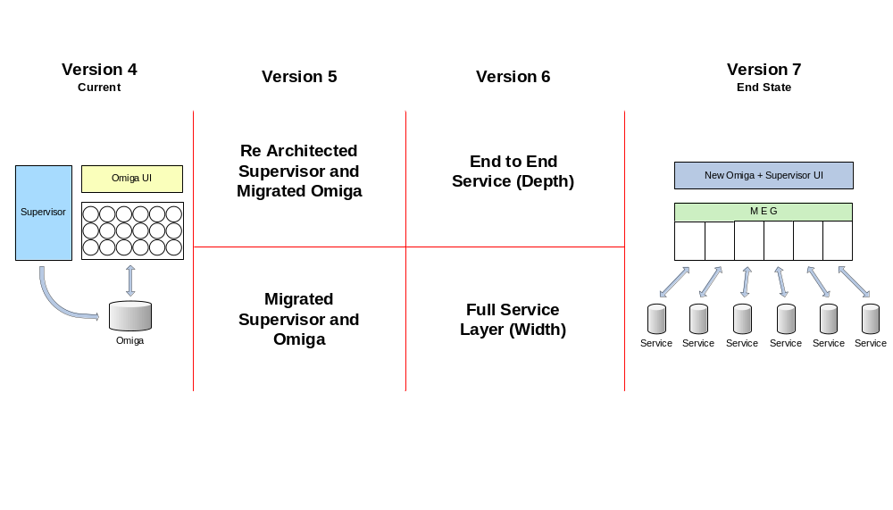
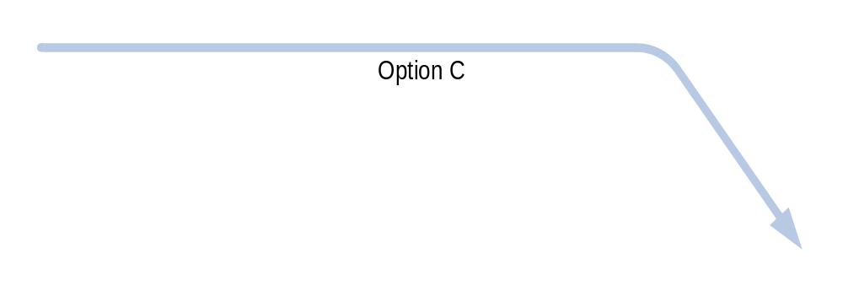
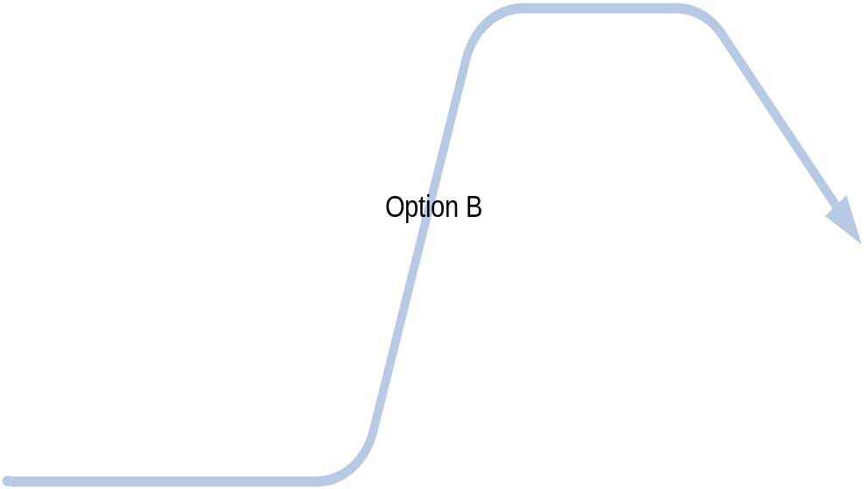
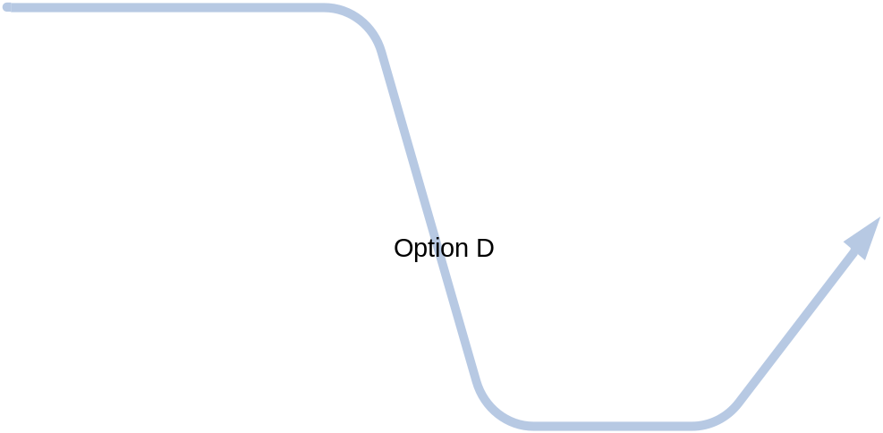

Roadmap Options Overview
Notes:
4 Routes to Omiga End State:
A. Migrate Supervisor + Service Layer
B. Migrate Supervisor + End to End Service
C. Re Architect Supervisor + End to End Service
D. Re Architect Supervisor + Service Layer

Slide 10
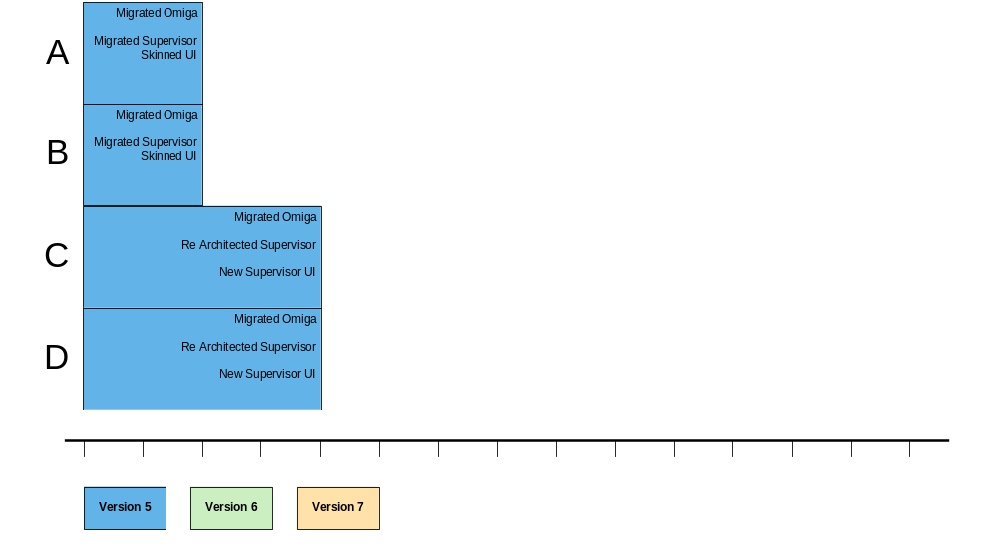
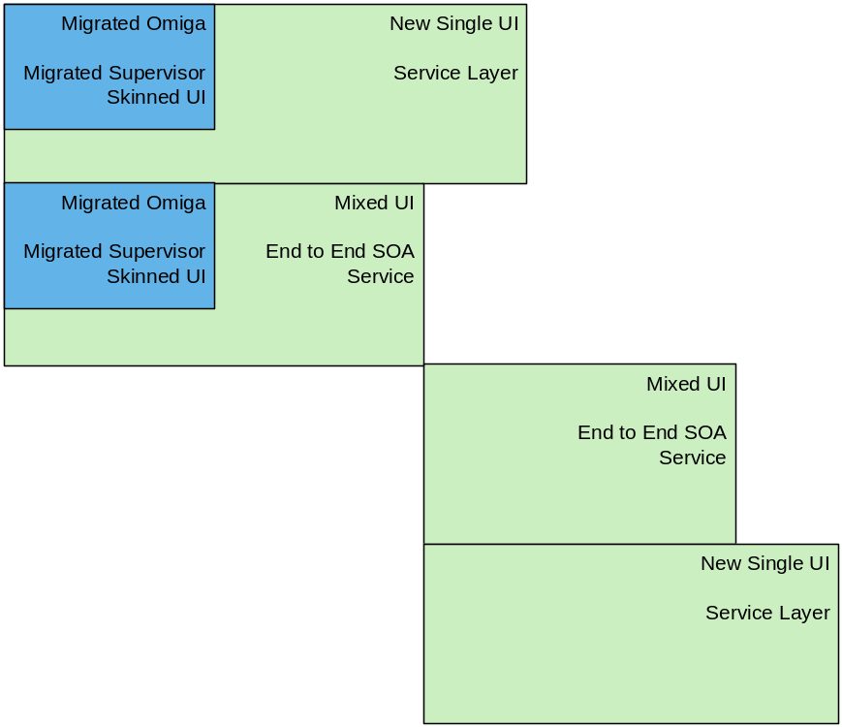
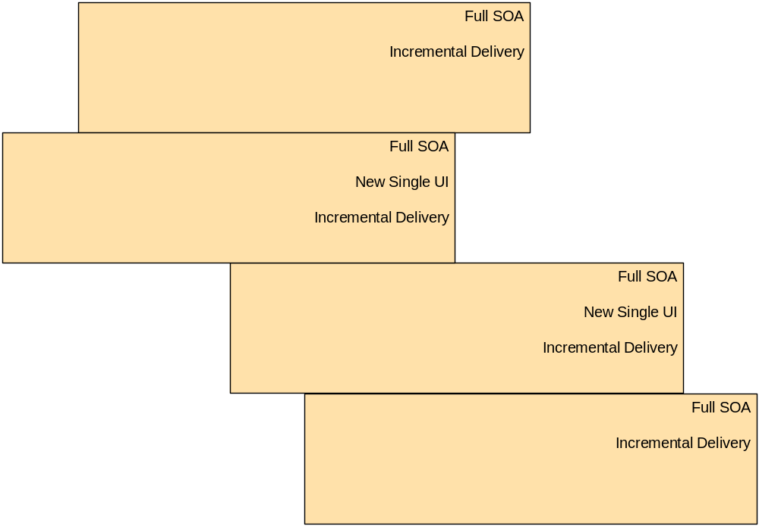
Illustrative Feature Timeline

Slide 11
Evaluation Criteria
Least throwaway Vertex work
Earliest to deliver business / sales benefit:
  Earliest to .NET
  Demonstrable SOA capability
  Single, consistent UI for Omiga and Supervisor
Earliest to end state
Easiest to maintain and add BAU updates

Slide 12
Recommendation
Option A:
  Migrate Supervisor with Omiga
    .NET delivered sooner than re-architecting Supervisor
    Least delivery risk for version 5 as outsourced to AiS
    Simpler deployment than re-architecting Supervisor
    Least mid-term rework of Supervisor
    Staff training not on critical path for release of version 5
  Start version 6
    Work can start in parallel to migration
    Start end state infrastructure
    Start full new consistent UI for Supervisor & Omiga
    Start full service layer (width)

Slide 13
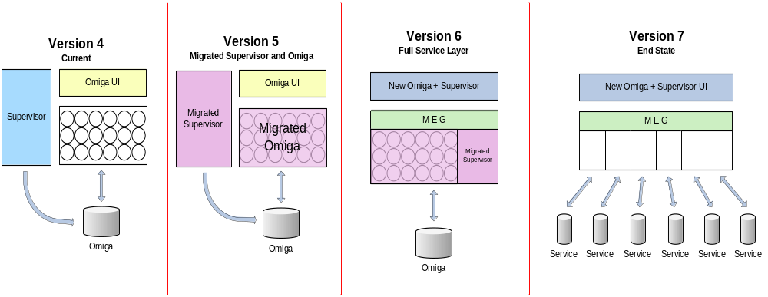
Recommendation (Option A)

Slide 14
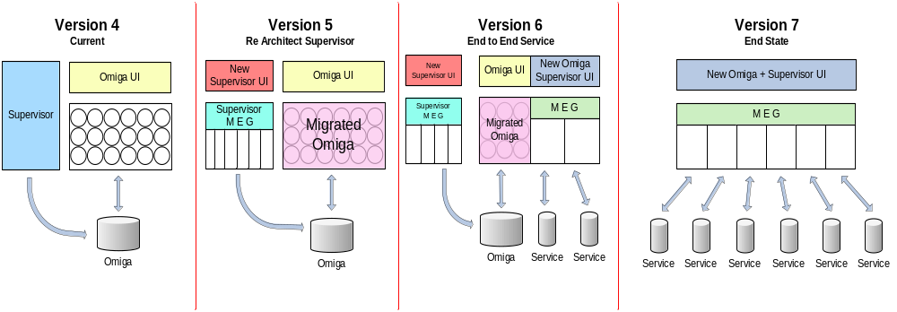
Re-architected Supervisor Option
(as outlined in the business case)

Slide 15
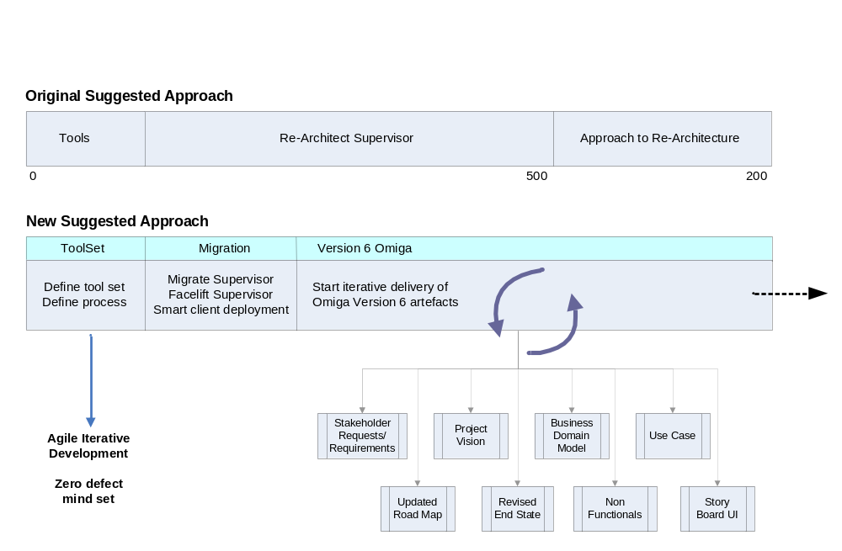
Revised Approach
Notes:
Stakeholder requests / requirements
Produce Business Process Model
Who: Stakeholders, (Martyn, Ren (VMS)..)
BAU / Consider Road Map Requirements (service level)
Capture non-functional requirements
Start Use Case Model
Identify Use Cases
Story-Board UI / Principles
Prototype Wire Frame for identified Use Case(s)
Start Business Model
1st Iteration of Business Domain Model
Start Software Architecture Document
Start first iteration plan (build by feature)
Project vision
Define scope
Initial view of service interface
Adopt / Investigate ORIGO Service Standard.

Slide 16
Next Steps
Agreement on road map to End State vision
Agreement to engage AiS regarding Migration of Supervisor
Agreement to retain any remaining allocation to be utilised towards “Approach to re-architecture” deliverables

